Slide 1
Binary Search Tree II

Slide 2
Binary Search Tree
Insert Function
Delete Function
Discussing Complexity

Slide 3
Insert Function
Let us insert 12
We need to find the position for the new Tree Node with the value 12
We need to make sure that it points to the parent Tree Node and the parent Tree node points to it (i.e it is connected)
15
6
18
3
7
17
20
2
4
13
9

Slide 4
Insert Function
root
Let us insert 12
We need to find the position for the new Tree Node with the value 12
We need to make sure that it points to the parent Tree Node and the parent Tree node points to it (i.e it is connected)
z
12
15
6
18
3
7
17
20
2
4
13
9

Slide 5
Insert Function
root
Let us insert 12
We need to find the position for the new Tree Node with the value 12
We need to make sure that it points to the parent Tree Node and the parent Tree node points to it (i.e it is connected)
z
12
15
6
18
x
3
7
17
20
2
4
13
y
9

Slide 6
Insert Function
y
root
Let us insert 12
We need to find the position for the new Tree Node with the value 12
We need to make sure that it points to the parent Tree Node and the parent Tree node points to it (i.e it is connected)
z
12
15
x
6
18
x
3
7
17
20
2
4
13
y
9

Slide 7
Insert Function
root
Let us insert 12
We need to find the position for the new Tree Node with the value 12
We need to make sure that it points to the parent Tree Node and the parent Tree node points to it (i.e it is connected)
z
12
15
y
6
18
x
x
3
7
17
20
2
4
13
y
9

Slide 8
Insert Function
root
Let us insert 12
We need to find the position for the new Tree Node with the value 12
We need to make sure that it points to the parent Tree Node and the parent Tree node points to it (i.e it is connected)
z
12
15
6
18
x
y
3
7
17
20
x
2
4
13
y
9

Slide 9
Insert Function
root
Let us insert 12
We need to find the position for the new Tree Node with the value 12
We need to make sure that it points to the parent Tree Node and the parent Tree node points to it (i.e it is connected)
z
12
15
6
18
x
3
7
17
20
y
2
4
13
x
y
9

Slide 10
Insert Function
root
Let us insert 12
We need to find the position for the new Tree Node with the value 12
We need to make sure that it points to the parent Tree Node and the parent Tree node points to it (i.e it is connected)
z
12
15
6
18
x
3
7
17
20
2
4
13
y
y
9
x

Slide 11
Insert Function
root
Let us insert 12
We need to find the position for the new Tree Node with the value 12
We need to make sure that it points to the parent Tree Node and the parent Tree node points to it (i.e it is connected)
15
6
18
x
3
7
17
20
2
4
13
y
z
y
9
12
x

Slide 12
Insert Function
root
Some observations:
The search goes on until x becomes NULL
y helps to refer to the parent
y helps in making the necessary connections
(y.right) and (x.parent) in this case
15
6
18
3
7
17
20
2
4
13
y
z
9
12
x

Slide 13
Insert Function (Empty Tree)
root
Some observations:
The search goes on until x becomes NULL
y helps to refer to the parent
y helps in making the necessary connections
(y.right) and (x.parent) in this case
z
12

Slide 14
Insert Function (Empty Tree)
y
root
Some observations:
The search goes on until x becomes NULL
y helps to refer to the parent
y helps in making the necessary connections
(y.right) and (x.parent) in this case
z
12
x

Slide 15
Insert Function (Empty Tree)
y
root
Some observations:
The search goes on until x becomes NULL
y helps to refer to the parent
y helps in making the necessary connections
(y.right) and (x.parent) in this case
x
12

Slide 16
Let us Write the Pseudocode

Slide 17
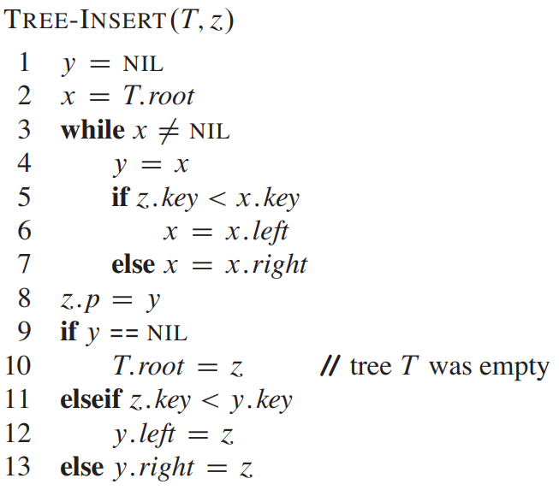
Let us Write the Pseudocode

Slide 18
Deletion
Before learning about deletion we need to know about another function
Transplant
replaces one subtree as a child of its parent with another subtree.\
Transplant (u,v)
u – node u is the parent of a subtree which will be replaced
v – node b is the parent of a subtree which replace the subtree rooted at u

Slide 19
Transplant
Root
15
6
18
3
7
17
20

Slide 20
Transplant
Case 1: u is the root
Root
u
15
v
6
18
25
3
7
17
21
20
30

Slide 21
Transplant
Case 1: u is the root
Root
u
v
25
15
21
30
6
18
3
7
17
20

Slide 22
Transplant
Case 1: u is the root
Root
u
v
25
15
21
30
6
18
3
7
17
20

Slide 23
Transplant
Case 2: u is a left child
Root
15
u
v
6
18
25
3
7
17
21
20
30

Slide 24
Transplant
Case 2: u is a left child
Root
15
u
v
18
25
17
20
21
30
6
3
7

Slide 25
Transplant
Case 2: u is a left child
Root
15
v
u
25
18
21
30
17
20
6
Transplant does not care about
the binary search property
3
7

Slide 26
Transplant
Case 3: u is a right child
Root
u
15
v
6
18
25
3
7
17
21
20
30

Slide 27
Transplant
Case 3: u is a right child
Root
15
v
6
25
3
7
21
30
u
18
17
20

Slide 28
Transplant
Case 3: u is a right child
Root
v
15
6
25
3
7
21
30
u
18
17
20

Slide 29
Transplant
The replaced child keeps on pointing to the parent.
This does not cause any issue.
Because any pointer outside the tree can point to any part of a tree.
It is okay, as long as the pointers inside the tree do not point some where else.
Let us observe case 3 again

Slide 30
Transplant
Case 3: u is a right child
Root
u
15
v
6
18
25
3
7
17
21
20
30

Slide 31
Transplant
Case 3: u is a right child
Root
u
v
15
6
25
18
30
21
3
7
17
20

Slide 32
Transplant
Case 3: u is a right child
Root
u
v
15
6
25
18
30
21
3
7
17
20

Slide 33
Transplant
Case 3: u is a right child
Root
u
v
15
6
25
18
30
21
3
7
17
20

Slide 34
Transplant
Case 3: u is a right child
Root
u
v
15
6
25
18
30
21
3
7
17
20

Slide 35
Transplant
Case 3: u is a right child
Root
u
v
15
6
25
18
30
21
3
7
17
20

Slide 36
Write the Pseudocode for Transplant

Slide 37
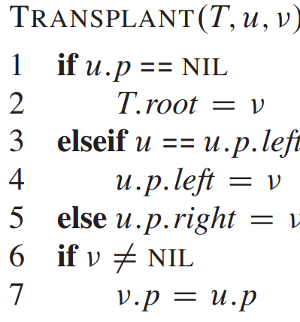
Write the Pseudocode for Transplant

Slide 38
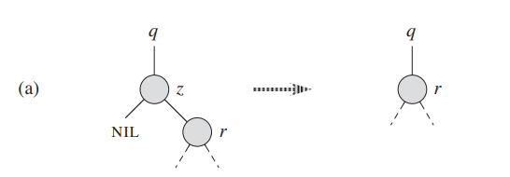
Deletion
Let us observe the following four cases:
Case 1: Node z (node to be deleted) has no left child

Slide 39
Deletion
Let us observe the following four cases:
Case 1: Node z (node to be deleted) has no left child
10
12
NIL
12
A simple transplant operation can get the task done
Transplat (z,z.right)

Slide 40
Deletion
Let us observe the following four cases:
Case 2: Node z (node to be deleted) has no right child
10
9
9
NIL
A simple transplant operation can get the task done
Transplat (z,z.left)

Slide 41
Deletion
Let us observe the following four cases:
Case 3:
Node z (node to be deleted) has both children
We need to find the minimum child on the right sub tree and the minimum value is not the immediate child
10
9
15
11
12

Slide 42
Deletion
Let us observe the following four cases:
Case 3:
Node z (node to be deleted) has both children
We need to find the minimum child on the right sub tree and the minimum value is not the immediate child
z
10
9
15
11
y
12

Slide 43
Deletion
Let us observe the following four cases:
Case 3:
Node z (node to be deleted) has both children
We need to find the minimum child on the right sub tree and the minimum value is not the immediate child
z
10
Let the minimum node be y
Transplant y with its right child
9
15
11
y
12

Slide 44
Deletion
Let us observe the following four cases:
Case 3:
Node z (node to be deleted) has both children
We need to find the minimum child on the right sub tree and the minimum value is not the immediate child
z
10
Let the minimum node be y
Transplant y with its right child
9
15
12
y
11

Slide 45
Deletion
Let us observe the following four cases:
Case 3:
Node z (node to be deleted) has both children
We need to find the minimum child on the right sub tree and the minimum value is not the immediate child
z
10
Let the minimum node be y
Transplant y with its right child.
Transplant z by y
9
15
12
y
11

Slide 46
Deletion
Let us observe the following four cases:
Case 3:
Node z (node to be deleted) has both children
We need to find the minimum child on the right sub tree and the minimum value is not the immediate child
y
11
Let the minimum node be y
Transplant y with its right child.
Transplant z by y
Make the parent child connections
on both the sides
10
z
9
15
12

Slide 47
Deletion
Let us observe the following four cases:
Case 3:
Node z (node to be deleted) has both children
We need to find the minimum child on the right sub tree and the minimum value is not the immediate child
11
Let the minimum node be y
Transplant y with its right child.
Transplant z by y
Make the parent child connections
on both the sides
10
9
15
12

Slide 48
Deletion
Let us observe the following four cases:
Case 3:
Node z (node to be deleted) has both children
We need to find the minimum child on the right sub tree and the minimum value is not the immediate child
11
Let the minimum node be y
Transplant y with its right child.
Transplant z by y
Make the parent child connections
on both the sides
10
9
15
12

Slide 49
Deletion
Let us observe the following four cases:
Case 3:
Node z (node to be deleted) has both children
We need to find the minimum child on the right sub tree and the minimum value is not the immediate child
11
Let the minimum node be y
Transplant y with its right child.
Transplant z by y
Make the parent child connections
on both the sides
9
15
12

Slide 50
Deletion
Let us observe the following four cases:
Case 4:
Node z (node to be deleted) has both children
We need to find the minimum child on the right sub tree and the minimum value is the immediate child
10
9
15
NIL
25

Slide 51
Deletion
Let us observe the following four cases:
Case 4:
Node z (node to be deleted) has both children
We need to find the minimum child on the right sub tree and the minimum value is the immediate child
z
10
y
9
15
NIL
25

Slide 52
Deletion
Let us observe the following four cases:
Case 4:
Node z (node to be deleted) has both children
We need to find the minimum child on the right sub tree and the minimum value is the immediate child
z
10
y
9
15
NIL
25

Slide 53
Deletion
Let us observe the following four cases:
Case 4:
Node z (node to be deleted) has both children
We need to find the minimum child on the right sub tree and the minimum value is the immediate child
y
15
NIL
25
z
10
9

Slide 54
Deletion
Let us observe the following four cases:
Case 4:
Node z (node to be deleted) has both children
We need to find the minimum child on the right sub tree and the minimum value is the immediate child
y
15
25
z
9
10

Slide 55
Deletion
Let us observe the following four cases:
Case 4:
Node z (node to be deleted) has both children
We need to find the minimum child on the right sub tree and the minimum value is the immediate child
15
25
9

Slide 56
Let us write the pseudocode for delete

Slide 57
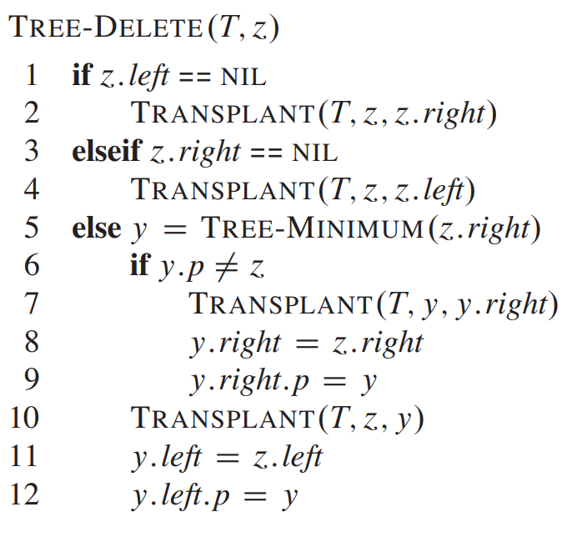
Let us write the pseudocode for delete

Slide 58
Time Complexity
The time required for each of the operations is O(h).
Because all the operations require pointers to climb down.
SEARCH – climbs down the height h
MINIMUM – climbs down the height h
MAXIMUM – climbs down the height h
PREDECESSOR – calls MAXIMUM
SUCCESSOR– calls MINUMUM
INSERT – climbs down the height h
DELETE – requires a call to MINIMUM – h
What is the value of h?

Slide 59
h=O(logn)
The above equation is applicable only if the tree is balanced.
Let us check it out.

Slide 60
Thank You

